Slide 1
ICT-PreAward-eCAT-
Pre_Award_Conformance_and_ Test_Framework-1.0.1
Version: 1.0.1
Status: In use
Editors: Giancarlo De Stefano, Consip

Slide 2
Statements
Statement of originality
This deliverable contains original unpublished work except where clearly indicated otherwise. Acknowledgement of previously published material and of the work of others has been made through appropriate citation, quotation or both.
Statement of copyright
This deliverable is released under the terms of the Creative Commons Licence accessed through the following link: http://creativecommons.org/licenses/by/3.0/.
In short, it is free to
Share — to copy, distribute and transmit the work
Remix — to adapt the work
Under the following conditions
Attribution — You must attribute the work in the manner specified by the author or licensor
(but not in any way that suggests that they endorse you or your use of the work).
Page <number>

Slide 3
Revision History
Version | Date | Editor | Org | Description
1.0.0 | 01.05.2011 | Hugo Oliveira | ANCP | First release
1.0.1 | 30.06.2012 | Giancarlo De Stefano | Consip | Update for alignement with PEPPOL EIA Release 4 and Transfer of Ownership
Page <number>

Slide 4
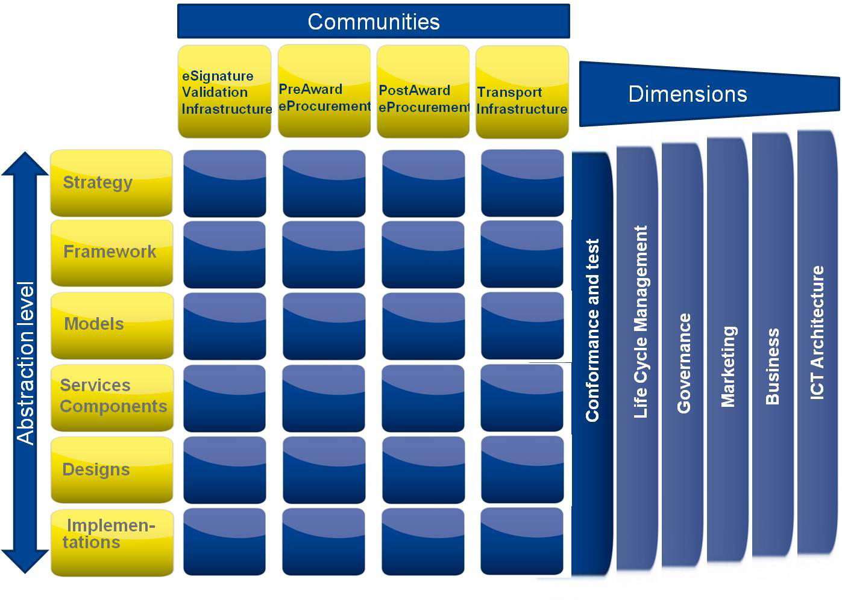

PEPPOL Conformance and Testing
Page <number>

Slide 5
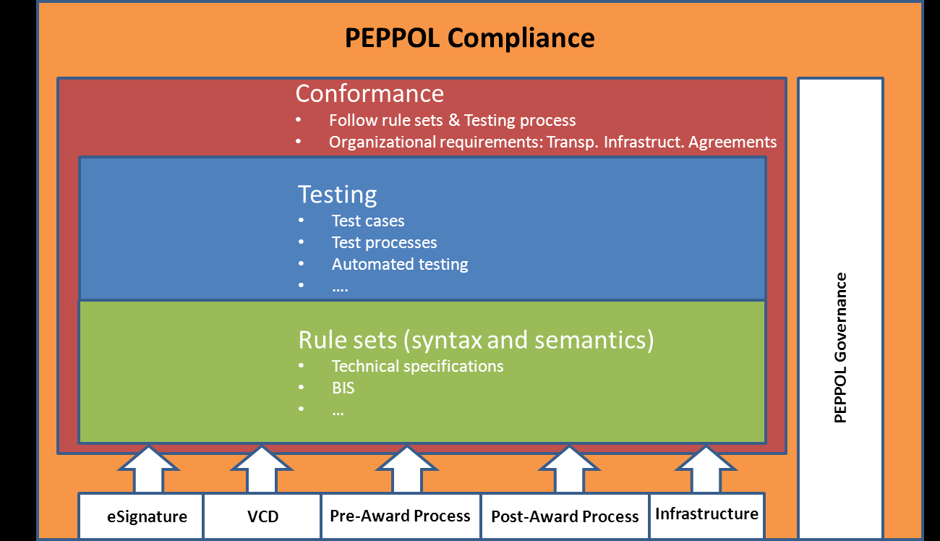

PEPPOL Compliance, Conformance and Test Framework
  PEPPOL uses the following model as the architecture for Compliance, Conformance and Tests
Page <number>

Slide 6
PEPPOL Compliance
  In the pre-award, means that an interoperability solution or implementation of a PEPPOL eProcurement process is conformant on all EIF 2.0 interoperability layers i.e. to all legal-and business-requirements and to process, semantic and technical solutions defined by PEPPOL or committed and approved by PEPPOL
Page <number>

Slide 7
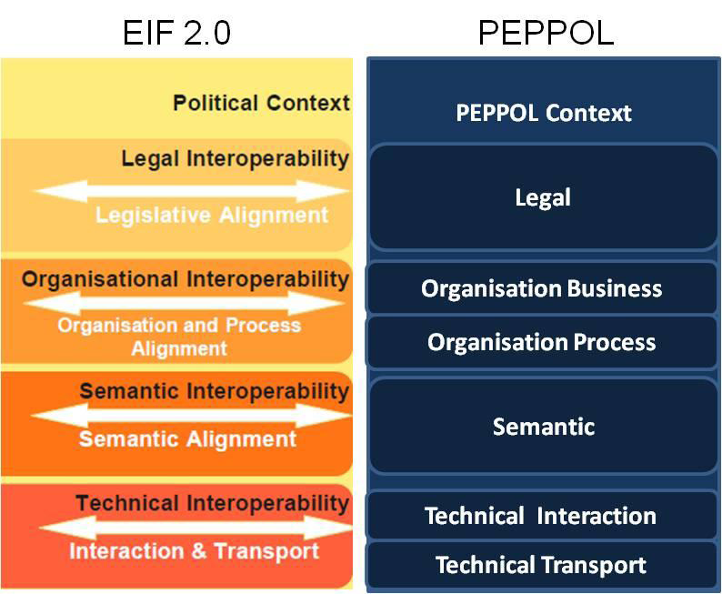
PEPPOL Conformance
  Scoped to one EIF interoperability layer
    Legal Requirement conformance
    Organisation Business Requirement conformance
    Organisation Process Solution Conformance
    Semantic Solution Conformance
    Technical Interaction ImplementationTesting
Page <number>

Slide 8

Conformance and testing 1
  Conformance is tested against a PEPPOL BIS on each EIF 2.0 Interoperability layer:
    Legal Requirement conformance
      Test method: Review requirements against own context
    Organisation Business Requirement conformance
      Test method: Review requirements against own context
    Organisation Process Solution Conformance
      Test method: use Technical Interaction Implementation Testing to claim solution conformance
    Semantic Solution Conformance
      Test method: use Technical Interaction Implementation Testing to claim solution conformance.
Page <number>

Slide 9
Conformance and testing 2
    Technical Interaction ImplementationTesting
      Test method: Use the Conformance and Test guideline to test the interoperability conformance of the implemented technical interaction in relation to a PEPPOL BIS
    Conformance and Test Guideline
      PEPPOL EIA>Conformance& Test> Models
      Contains test plan, test scenarios, test cases and test criteria for claiming conformance
Page <number>

Slide 10
Conformance claim
  PEPPOL BIS Implementations claim for conformance is done through self assessment, where the Conformance and Test Guideline sets the test criteria
  Test documentation must be provided to the Regional Authority
    All tests must be described and documented in the PEPPOL test case management tool at http://peppol.phloc.com/.
    When conformancehas been claimed, the specific test plan is placed in PEPPOL EIA>Conformance& Test> Designs and a summary of the results is placed in PEPPOL EIA>Conformance& Test> Implementations
Page <number>

Slide 11

eProcurement
without borders in Europe
www.peppol.eu
Page <number>

